Slide 1

Micro processor
第6组
邓贵杭
刘展志
杨林
朱思强
王宇航

Slide 2
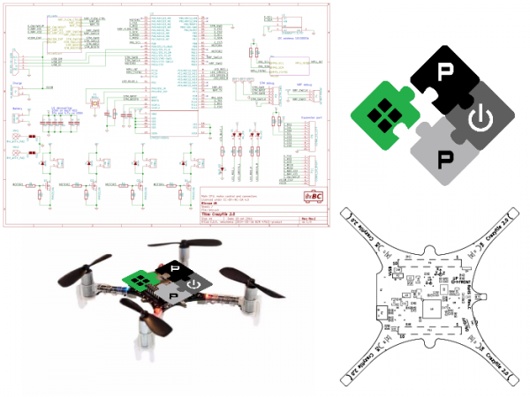
利用PULP仿真控制机械臂

Slide 3
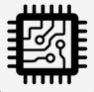



content
01 project introduction
02 implement process
03 progress of each week
04 result display

Slide 4
01 project introduction
02 implement process
03 progress of each week
04 result display

Slide 5
project introduction
PULP
FPGA、
Mechanical arm
software
hardware

Slide 6
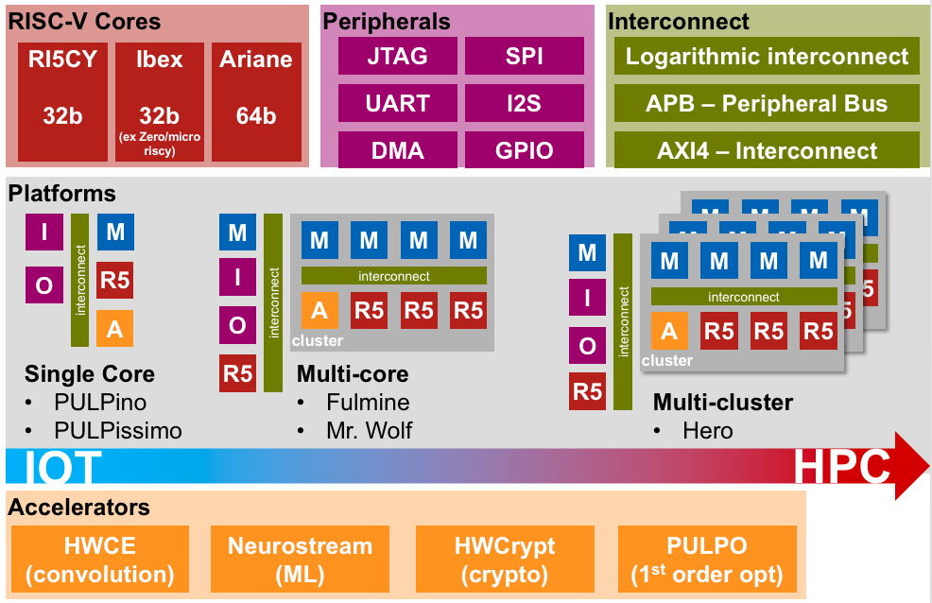
project introduction——pulp

Slide 7
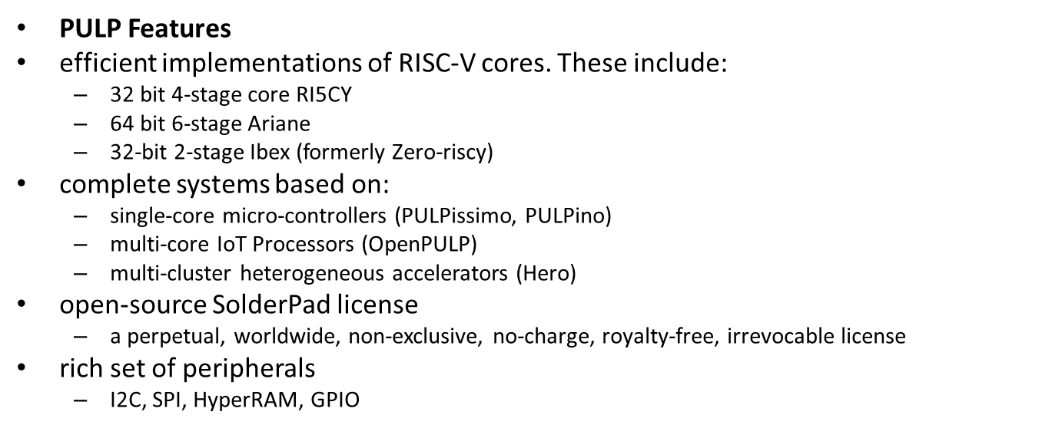
project introduction——pulp

Slide 8
Project introduction—— PULP
01
What is PULP
PULP is a Parallel Ultra Low Power platform targeting high energy efficiencies.
The PULP platform is open-source and free and is meant to be used by other research institutes, universities, and companies.
consists of a set of IPs described in the System Verilog hardware description language (HDL), the related simulation and synthesis scripts, RISC-V assembly to enable using the platform.

Slide 9
Project introduction—— PULP
02
How to use PULP
The software running on PULP/PULPino is written in RISC-V assembly and in C
Xilinx FPGAs and used Xilinx Vivado for FPGA synthesis
port the platform to other FPGA vendors

Slide 10
Project introduction—— PULP
01
What is PULPino
an open-source single-core microcontroller system, based on 32-bit RISC-V cores developed at ETH Zurich
configurable to use either the RISCY or the zero-riscy core
RISCY: with 4 pipeline stages and it has an IPC close to 1, full support for the base integer instruction set (RV32I), compressed instructions (RV32C) and multiplication instruction set extension (RV32M)
zero-riscy: with 2 pipeline stages and it has full support for the base integer instruction set (RV32I) and compressed instructions (RV32C)

Slide 11
Project introduction—— PULP
02
How to use
contains a broad set of peripherals, including I2S, I2C, SPI and UART.
internal devices can be accessed from outside via JTAG and SPI
boots from an internal boot ROM and loads its program from an external SPI flash
PULPino can be synthesized and run on a Arty A7-board

Slide 12
01 project introduction
02 implement process
03 progress of each week
04 result display

Slide 13
Preparation
Download the source code
git clone https://github.com/pulp-platform/pulpino
cd pulpino
./update-ips.py

Slide 14
Preparation
2. Compile toolchain
git https://github.com/pulp-platform/ri5cy_gnu_toolchaincd
ri5cy_gnu_toolchainmake

Slide 15
implement process
Generate the constrain file(.xdc)
Write the control command(Written by C)
Wave Simulation in modelsim(.vsimc)
Generate the memory init file(.coe)
Generate bit stream by using vivado
Load the bit stream to the FPGA
FPGA output the PWM signal
Mechanical arm moves with the PWM signal

Slide 16
01 project introduction
02 implement process
03 progress of each week
04 result display

Slide 17
progress of each week
week 12: analyzing the project and plan making
Week 13: Arduino learning and SDK building
Week 14: vivado installing, RUNLED demo testing
Week 15: simulating the PWM signal, compiling the pulpino and defining the pin Week 16: using the FPGA to control the mechanical arm and pulpino compiling

Slide 18
01 project introduction
02 implement process
03 progress of each week
04 result display

Slide 19
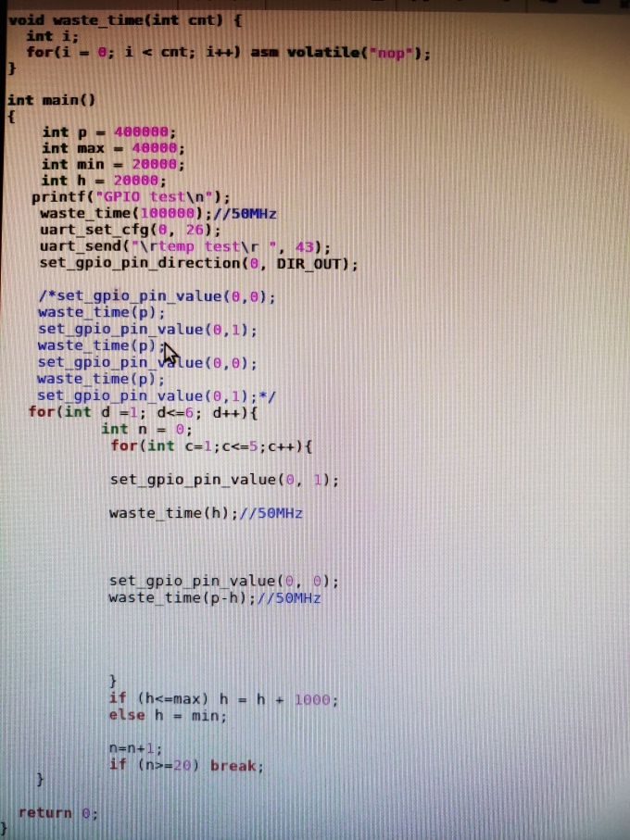
result display
Control command

Slide 20
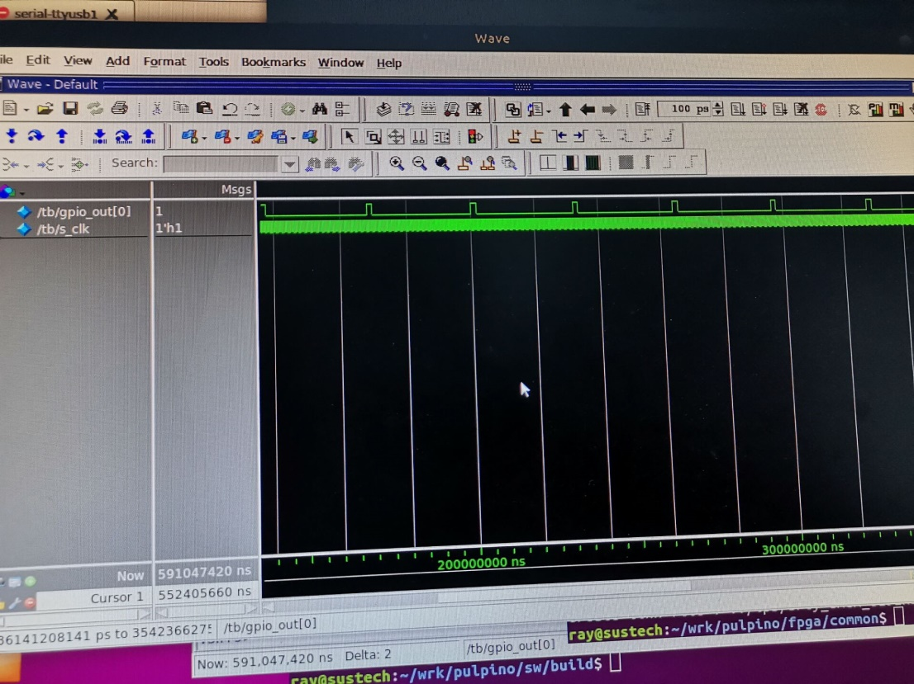
result display
Simulation in modelsim

Slide 21
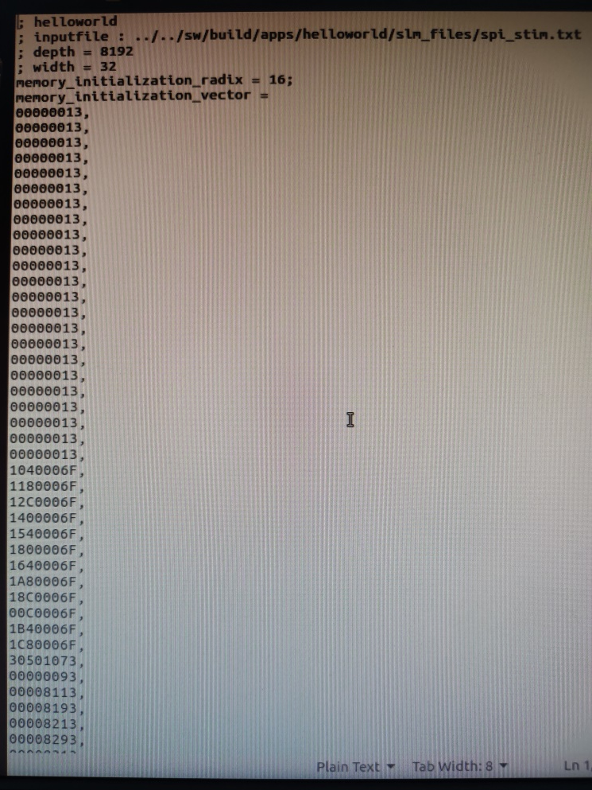
result display
Generate the memory init file(.coe)

Slide 22
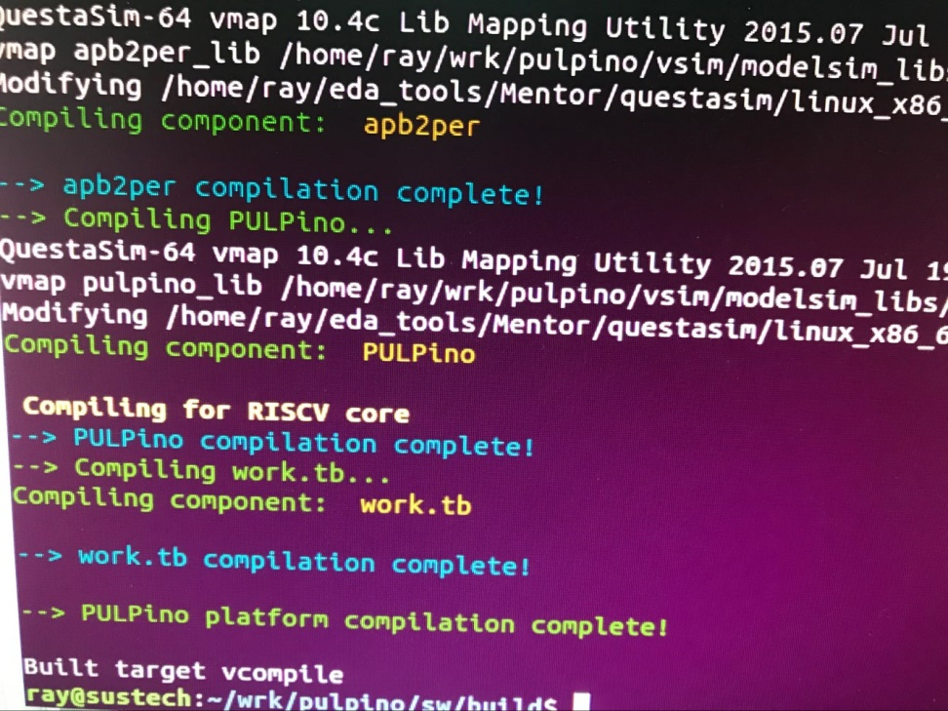
result display
Compiling using the RISCV core

Slide 23
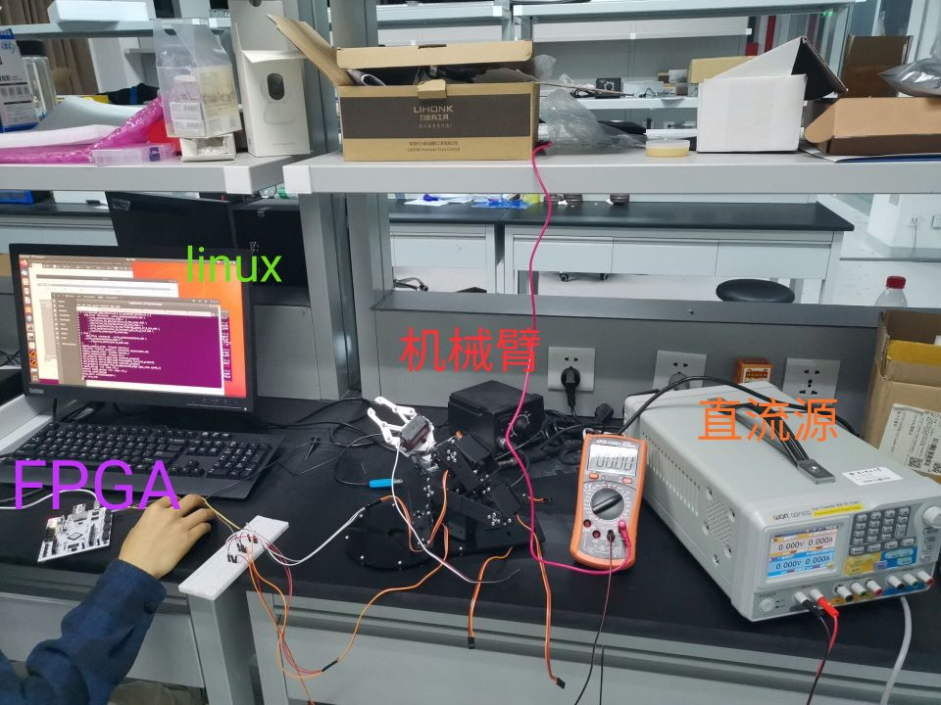
result display
Mechanical arm moves with the PWM signal

Slide 24
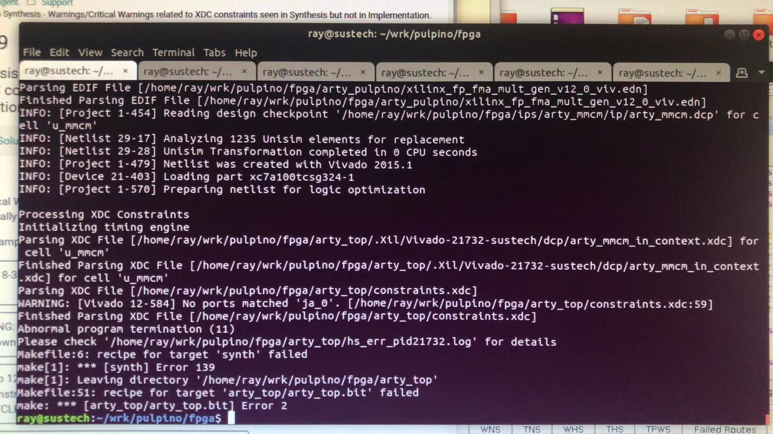
A problem
No port matched
No signal detected

Slide 25
Thank you

